Slide 1
Comparative Study and Practical Analysis of Generative AI Models
Autoencoder • VAE • DCGAN • Stable Diffusion
Soham Sabane (202401110070)
Rushikesh Hande (202401110056)
Yadnesh Tayade (202401110057)
CO3 + CO4
Notes:
Yadnesh: Introduce the group and the aim. We compared four generative models: Autoencoder and VAE for image reconstruction (CO3), and DCGAN and Stable Diffusion for image generation (CO4). We ran ready-made notebooks in Google Colab and analysed the outputs.

Slide 2
Four models, two jobs
AE
Autoencoder
VAE
Variational AE
Encoder squeezes the image into a latent code; decoder rebuilds it. Minimises reconstruction error.
Encodes a distribution (mean, variance) and samples from it. Loss adds a KL term.
GAN
DCGAN
SD
Stable Diffusion
Generator and discriminator compete. Convolutional layers make images from noise.
Pretrained model that denoises step by step in latent space, guided by a text prompt.
Notes:
Yadnesh: AE and VAE both compress and rebuild an image. The VAE adds a probability distribution, which gives a smooth latent space. DCGAN uses two competing networks. Stable Diffusion removes noise step by step and follows a text prompt.

Slide 3
Comparison at a glance
 | AE | VAE | DCGAN | Stable Diffusion
Core idea | Compress and rebuild | Latent distribution + KL loss | Generator vs discriminator | Iterative denoising with text guidance
Strength | Simple, fast, accurate reconstruction | Smooth latent space, can generate | Sharp, fast one-pass generation | Most realistic, prompt control
Limitation | Poor at creating new images | Blurry outputs | Unstable, mode collapse | Slow, needs GPU, odd hands or text
Output | Close to input, slight blur | Smoother, blurrier than AE | Sharp but small, artefacts | Detailed and photorealistic
Applications: AE denoising and compression | VAE anomaly detection | DCGAN augmentation | SD text-to-image art
Notes:
Rushikesh: Walk across the table. Reconstruction models are about fidelity, generation models are about creating new content. Point out that VAE trades sharpness for a better latent space, and diffusion gives the best quality at the highest compute cost.

Slide 4
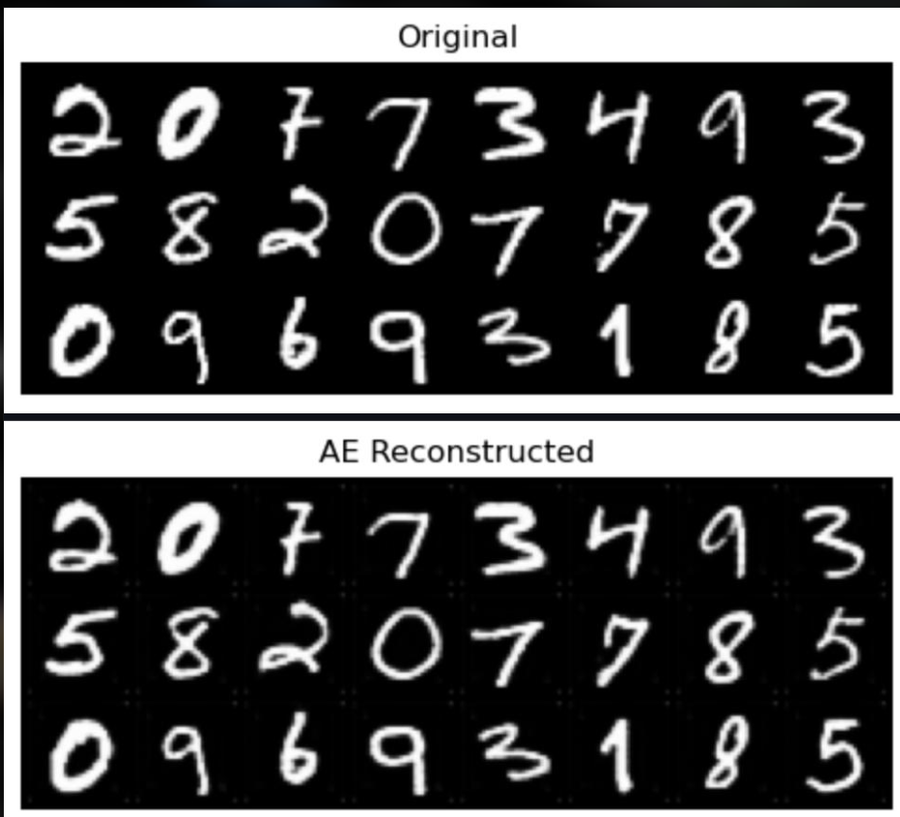
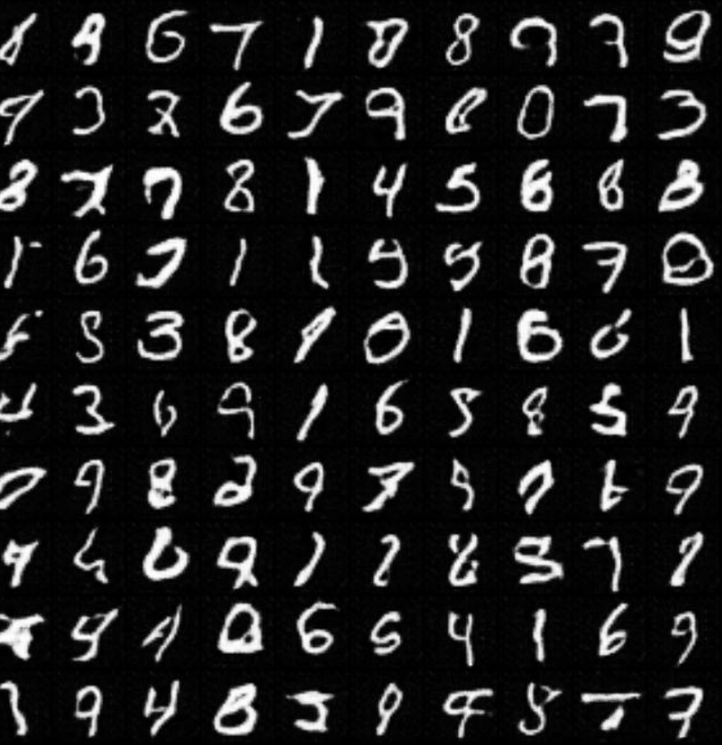
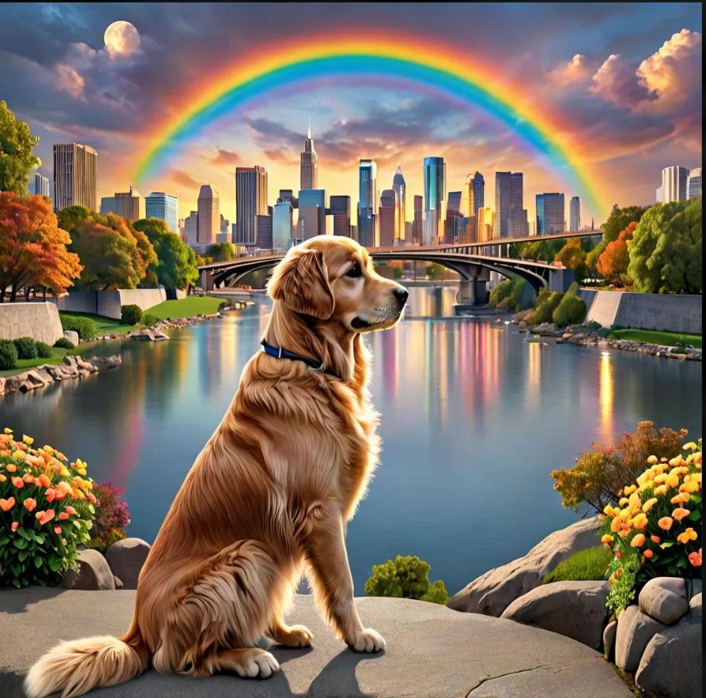
Practical results from Google Colab
AE reconstruction
DCGAN
Stable Diffusion
Almost identical to the original digits; faint dots on the background.
Readable 28x28 digits, but many are broken or ambiguous.
Sharp, detailed and realistic; slightly over-saturated look.
Notes:
Soham (Activity A): Show the Autoencoder result. The reconstructed digits are almost identical to the originals because the AE only minimises reconstruction error. A VAE normally gives smoother and blurrier output because of the KL term. Rushikesh (Activity B): DCGAN generates small 28x28 digits in one pass, but many have broken strokes. Stable Diffusion gives a detailed, realistic image from a text prompt, but needs a GPU and many denoising steps.

Slide 5
Conclusion and reflection
Key learning
AI usage and verification
AE gives accurate reconstruction; VAE gives a smooth latent space
DCGAN is fast but unstable
Diffusion gives the best realism at higher cost
Pick the model by need: fidelity, speed or quality
Tools: Claude for drafting and explanation
Prompts: comparison table, VAE vs AE blur
Checked against original papers and PyTorch / Hugging Face docs
Results verified from our own Colab outputs
Notes:
Soham: Summarise learning outcomes. Yadnesh: Explain the AI tools used and how we verified the content against the papers and documentation. Each member should be ready to answer questions on all four models and both activities. Thank the audience and invite questions.

